Slide 1
Math 170 Functions, Data, and Models
44 Inverses
Section 10.2

Slide 2
Basic Concepts
A function is a rule that assigns to each possible input exactly one output. A function can be expressed with words, tables, graphs, or formulas. Special types of functions include linear, quadratic, exponential, logarithmic, and trigonometric.
Suppose $Q=f(t)$ is a function with the property that each value of $Q$ determines exactly one value of $t$. Then $f$ has an inverse function, $f^{−1}$, and
$f^{−1}\left(Q\right)=t$ if and only if $Q=f(t)$.
If a function has an inverse, it is said to be invertible.

Slide 3
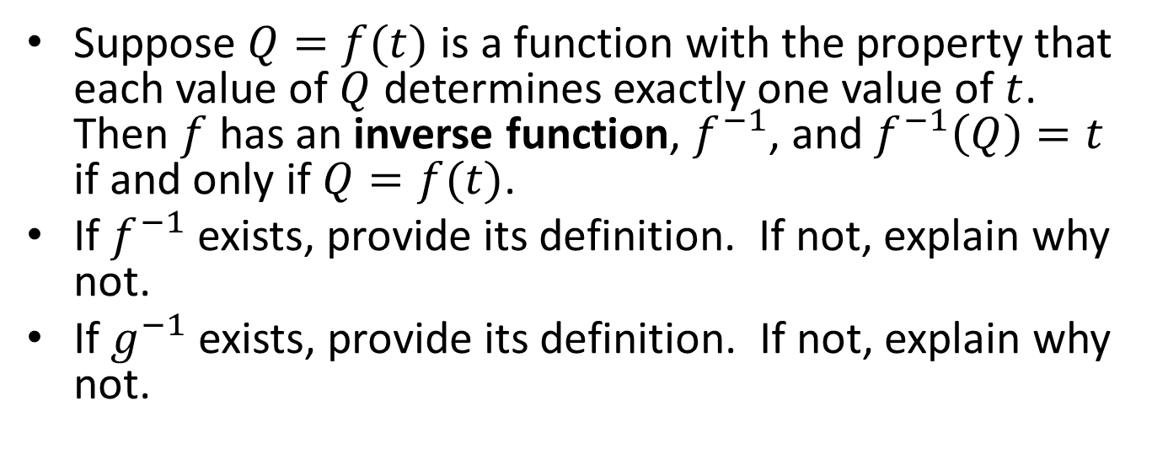
Table Inverses
Suppose $Q=f(t)$ is a function with the property that each value of $Q$ determines exactly one value of $t$. Then $f$ has an inverse function, $f^{−1}$, and $f^{−1}\left(Q\right)=t$ if and only if $Q=f(t)$.
If $f^{−1}$ exists, provide its definition. If not, explain why not.
If $g^{−1}$ exists, provide its definition. If not, explain why not.
t | 1 | 2 | 3 | 4
f(t) | 3 | 5 | 0 | 1
g(t) | 3 | 2 | 1 | 3
t | 0 | 1 | 3 | 5
f⁻¹(t) | 3 | 4 | 1 | 2
$g\left(1\right)=g\left(4\right)=3$. Thus, $g^{−1}\left(3\right)$ cannot be defined

Slide 4
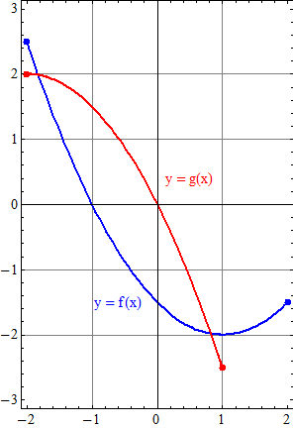
Graph Inverses
If $f^{−1}$ exists, sketch its graph. If not, explain why not.
If $g^{−1}$ exists, sketch its graph. If not, explain why not.

Slide 5
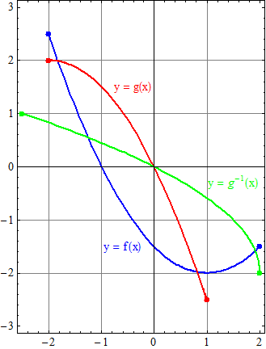
Graph Inverses Answers
$f^{−1}$ does not exist because $f\left(0\right)=f\left(2\right)=−1.5$ and so $f^{−1}(−1.5)$ does not exist.
$g^{−1}$ exists.

Slide 6
Formula Inverses
For each of the following functions either find its inverse or explain why an inverse does not exist.
$a\left(x\right)=3x−2$
$b\left(x\right)=\frac{x−2}{5x+1}$
$c\left(x\right)=x^{4}−1$
$d\left(x\right)=\log{(7x+2)}$
$e\left(x\right)=4−\sqrt{x}$
$f\left(x\right)=2^{x}+x^{2}$
$g\left(x\right)=3\sin{x}$

Slide 7
Formula Inverses Answers
For each of the following functions either find its inverse or explain why an inverse does not exist.
$a\left(x\right)=3x−2$ $a^{−1}\left(y\right)=\frac{1}{3}(y+2)$
$b\left(x\right)=\frac{x−2}{5x+1}$ $b^{−1}\left(y\right)=\frac{y+2}{1−5y}$
$c\left(x\right)=x^{4}−1$ $c\left(−2\right)=c(2)$
$d\left(x\right)=\log{(7x+2)}$ $d^{−1}\left(y\right)=\frac{1}{7}{(10}^{y}−2)$
$e\left(x\right)=4−\sqrt{x}$ $e^{−1}\left(y\right)={(4−y)}^{2}$
$f\left(x\right)=2^{x}+x^{2}$ $f^{−1}$ exists but no formula
$g\left(x\right)=3\sin{x}$ $g\left(0\right)=g(π)$

Slide 8
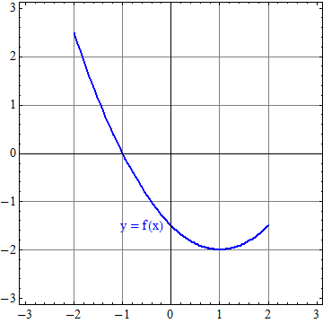
Restricting the Domain
Restrict the domain of $f$ in two ways to obtain two inverse functions.

Slide 9
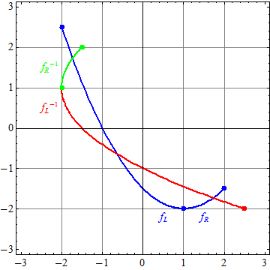
Restricting the Domain Answer
Restrict the domain of $f$ in two ways to obtain two inverse functions.

Slide 10
Word Inverses
Let $H(t)$ be the temperature, in °C, of a piece of pottery $t$ seconds after removal from a kiln where $0≤t≤300$. If $H^{−1}$ exists, describe it. If not, explain why not.
$H^{−1}(q)$ is the number of seconds after removal from a kiln of the piece of pottery when it has reached the temperature $q$ °C.
Let w$(y)$ be the weight, in kilograms, of the instructor $y$ years after he was born where $0≤y≤30$. If $w^{−1}$ exists, describe it. If not, explain why not.
The instructor’s weight has fluctuated up and down since reaching adulthood.

